Slide 1




An unequal start: Impact of age of school entry on grade repetition and academic performance in Grades 1-4
Early Childhood Systems: Perspectives and Research Webinar
Bianca Böhmer
04 February 2026

Slide 2
Outline
Introduction
Data
SA School Admissions Legislation
Methodology
Results
Discussion and Conclusion

Slide 3
Introduction

Slide 4
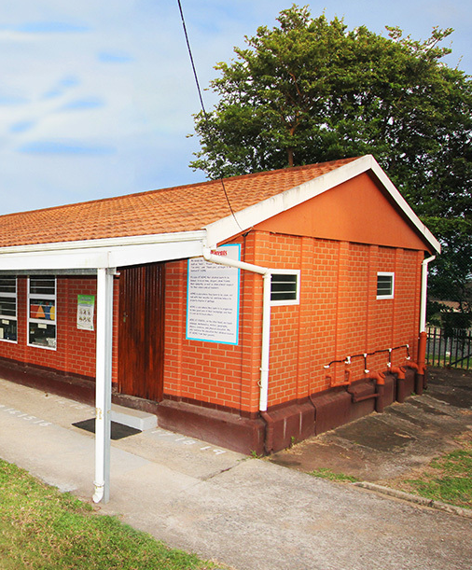
Does a child’s school starting age matter?
Policy relevance
Entrance age policy and cost-efficiency, compulsory Grade R and BELA (2024)
Relevance to parents
Decisions about the appropriate age to send their child to school
https://elangenibuildings.co.za/elangeni-classrooms/

Slide 5
Introduction | Primary school entry age
School-entry age for countries and territories, 1980–2022
Primary School entry age has been declining over time
Most common primary starting age is 6 years old
(~70% of countries)
Percentage of countries
Source: UENSCO Institute of Statistics. Used indicator: “Official entrance age to primary education (years)” [299905]. Dataset last updated in November 2025. A total of 224 countries and regions in 2022
Notes:
Make point – Global view (all countries and some territories)
Talk people through it. Colours, shape etc.
Of the 79 countries that participated in PISA 2018, 5 started at 5 years and 14 at 7 years, the remining started at 6 years (Givord, 2020)

Slide 6
Introduction | Relative age effect
Relative age effect
Differences in schooling outcomes and school experience due to a child’s relative age within their school cohort

Slide 7
Introduction | Relative age effect
Relative age effect
Differences in schooling outcomes and school experience due to a child’s relative age within their school cohort
Minimum school
entry thresholds
Clear regulations in most schooling systems relating to minimum starting ages or compulsory school ages
Single annual
intake
The school year is 12-months long; there is only a single opportunity to start in every calendar year
Birthdate determines position in cohort
When in the year a child is born determines whether they are young or old for their cohort

Slide 8

Introduction | Relative age effect
Relative age effect
Differences in schooling outcomes and school experience due to a child’s relative age within their school cohort
Youngest in grade
Oldest in grade

Slide 9
Introduction | Relative age effect
Relative age effect
Differences in schooling outcomes and school experience due to a child’s relative age within their school cohort
Youngest in grade
Oldest in grade
1 year
Developmentally significant difference at a young age
Notes:
Provide Example – using months of birth (eg. Comparing a Jan vs. Nov child)

Slide 10
Introduction | Relative age effect
A child’s month of birth is correlated with a long list of outcomes. Older learners:
Score higher marks on standardised assessments¹
Have lower grade
retention²
Have a lower likelihood of learning disability diagnosis³
Attain higher levels of
schooling⁴
Less likely to be
bullied⁵
Show more leadership
skills⁶
1. Bedard & Dhuey, 2006; Herbst & Strawiński, 2016; Givord, 2020 ; 2. Corman, 2003; Elder & Lubotsky, 2009; Pedraja-Chaparro et al., 2015; Givord, 2020 ; 3. Elder & Lubotsky, 2009 ; 4. Angrist & Krueger, 1991; Bedard & Dhuey, 2006 ; 5. Ballatore et al., 2020 ; 6. Dhuey & Lipscomb, 2008 ; 7. Bedard & Dhuey, 2006 ; 8.Fredriksson & Ockert, 2005; Kawaguchi, 2011 ; 9. Solli, 2017 ; Valdés, 2024
Notes:
Don not mention age at test

Slide 11
Introduction | Relative age effect
A child’s month of birth is correlated with a long list of outcomes. Older learners:
Score higher marks on standardised assessments¹
Have lower grade
retention²
Have a lower likelihood of learning disability diagnosis³
Attain higher levels of
schooling⁴
Less likely to be
bullied⁵
Show more leadership
skills⁶
More likely to attend a university or college⁷
Higher starting wages⁸
Relative age effects tend to be larger for lower-income learners and boys⁹
1. Bedard & Dhuey, 2006; Herbst & Strawiński, 2016; Givord, 2020 ; 2. Corman, 2003; Elder & Lubotsky, 2009; Pedraja-Chaparro et al., 2015; Givord, 2020 ; 3. Elder & Lubotsky, 2009 ; 4. Angrist & Krueger, 1991; Bedard & Dhuey, 2006 ; 5. Ballatore et al., 2020 ; 6. Dhuey & Lipscomb, 2008 ; 7. Bedard & Dhuey, 2006 ; 8.Fredriksson & Ockert, 2005; Kawaguchi, 2011 ; 9. Solli, 2017 ; Valdés, 2024

Slide 12
Other factors and considerations
Peer Effects
Relative age within your cohort also matters. Negative spillover from younger classmates and positive spillover from older classmates (Cascio & Schanzenbach, 2016; Elder and Lubotsky, 2009; Peña, 2017)
Advantages of starting early
Trade-off between later schooling start and the opportunity cost of a lost year of earning. Ambiguous effects on earnings over lifespan (Fredriksson & Ockert, 2005)

Slide 13
Other factors and considerations
Peer Effects
Relative age within your cohort also matters. Negative spillover from younger classmates and positive spillover from older classmates (Cascio & Schanzenbach, 2016; Elder and Lubotsky, 2009; Peña, 2017)
Fade-out due to age
A 1-year gap, relatively smaller at older ages.
Relative age effect fades in later grades (Elder and Lubowski, 2009; Robertson, 2011; Herbst & Strawiński, 2016)
Advantages of starting early
Trade-off between later schooling start and the opportunity cost of a lost year of earning. Ambiguous effects on earnings over lifespan (Fredriksson & Ockert, 2005)

Slide 14
Other factors and considerations
Peer Effects
Relative age within your cohort also matters. Negative spillover from younger classmates and positive spillover from older classmates (Cascio & Schanzenbach, 2016; Elder and Lubotsky, 2009; Peña, 2017)
Fade-out due to age
A 1-year gap, relatively smaller at older ages.
Relative age effect fades in later grades (Elder and Lubowski, 2009; Robertson, 2011; Herbst & Strawiński, 2016)
Advantages of starting early
Trade-off between later schooling start and the opportunity cost of a lost year of earning. Ambiguous effects on earnings over lifespan (Fredriksson & Ockert, 2005)
Rate of learning per year
Is there divergence or convergence in the system.
Problem if younger learners also learn less over one year.

Slide 15
Data

Slide 16



DDD is the core dataset
Learner panel
2017 - 2023
Data from six provinces
Learning outcomes in Gr 1 & Gr 4
Allows for tracking from one grade to the next
Provinces in dataset: EC, GT, KZN, LP, MP & NW
Two outcomes: Repetition & Term 4 marks (Home language)

Slide 17
Tracked a single Grade 1 cohort from 2018
Grade 1
Grade 4
Track 2018 Gr 1 cohort,
first-time entrants only
Balanced panel
across Gr 1 & Gr 4
Used a same-grade approach
Learners complete Grade 4 in different years, depending on repetition status
Notes:
Any children we could pick up in both grades we included in a
→ This give us a blanced panel (same kids in both grade)

Slide 18
Tracked a single Grade 1 cohort from 2018
Number of learners in the balanced panel of Grade 1 2018 first-time entrants
Grade | 2018 | 2019 | 2020 | 2021 | 2022 | 2023
1 | 680 068 | - | - | - | - | -
4 | - | - | 611 | 509 382 | 152 763 | 17 312

Slide 19
South African Admissions Legislation

Slide 20
Two sections in SASA outline age range
Minimum admission age
Compulsory school age
Grade R
Four turning five by 30 June
Attend school from year in which the learner reaches the age of six
BELA only
Grade 1
Five turning six by 30 June
Attend school from year in which learner reaches the age of seven
Source: Minimum age - Section 3 of South African Schools Act, 1996 updated in Act No. 50 of 2002 ; Compulsory school age - (Section 3 of South African Schools Act, 1996 updated in GN 19377, 19 October 1998)

Slide 21
Two sections in SASA outline age range
On the 1st of Jan
Minimum admission age
Compulsory school age
Grade R
4½ yrs old
6 yrs old
Grade 1
5½ yrs old
7 yrs old
Source: Minimum age - Section 3 of South African Schools Act, 1996 updated in Act No. 50 of 2002 ; Compulsory school age - (Section 3 of South African Schools Act, 1996 updated in GN 19377, 19 October 1998)

Slide 22
Correct entry age norms and school readiness
Early entry
Delayed Entry
(“Red shirting”)
Parents believe their child is school-ready or starting early is to their advantage
Or due to family or child constraints
Parents believe their child is not school-ready, or think a later start is advantageous
Or due to family situation or child characteristics
Souce: Giovord (2022); Herbst & Strawiński (2016)
Notes:
IN SA what this might look like is XXX….. (Possible reasons for early or delayed entry)

Slide 23
High compliance with correct school-entry-ages
Grade R
Grade 1
Source: DDD learner panel, 2017 – 2023 for 6 provinces: EC, GT, KZN, LP, MP and NW.
Notes:
Do faster….
Focus only on Grade 1

Slide 24
Grade 1 age of first-time entry by month of birth
Source: DDD learner panel, 2017 – 2023 for 6 provinces: EC, GT, KZN, LP, MP and NW.
Notes:
Try to shorten the explanation – but keep clear

Slide 25
Grade 1 age of first-time entry by month of birth
Source: DDD learner panel, 2017 – 2023 for 6 provinces: EC, GT, KZN, LP, MP and NW.
Notes:
Try to shorten the explanation – but keep clear

Slide 26
Grade 1 age of first-time entry by month of birth
Minimum age
threshold
Source: DDD learner panel, 2017 – 2023 for 6 provinces: EC, GT, KZN, LP, MP and NW.
Notes:
Try to shorten the explanation – but keep clear

Slide 27
Grade 1 age of first-time entry by month of birth
Minimum age
threshold
Maximum age
threshold
Source: DDD learner panel, 2017 – 2023 for 6 provinces: EC, GT, KZN, LP, MP and NW.
Notes:
Try to shorten the explanation – but keep clear

Slide 28
Two de-facto school-entry-age policies emerge
5.5
6
6.5
7
Age of Gr1 first entry
(1st Jan)
18-month age range

Slide 29
Two de-facto school-entry-age policies emerge
5.5
6
6.5
7
Age of Gr1 first entry
(1st Jan)
Mid-year Policy
5 ½ to 6 ½ yrs
Born: Jul-Jun
Calendar Year Policy
6 to7 yrs
Born: Jan-Dec
(Youngest possible range for correctly-aged entry)
(Oldest possible range for
correctly-aged entry)

Slide 30
Summary Statistics | By school-entry-age policy type
 | Applied school-entry-age policy
Variable | Mid-year | Calendar Year | Total
Age in Gr 1 (On 1st Jan) | 6.1 | 6.5 | 6.1
Home Lang. mark (%) | 65.2 | 67.2 | 65.5
Maths mark (%) | 69.5 | 72.1 | 69.8
First Add. Lang. mark (%) | 66.2 | 69.2 | 66.5
Repeated Gr 1 | 13% | 10% | 13%
Repeated at least once in FP | 25% | 18% | 25%
Repeated Gr 4 | 7% | 5% | 7%
Observations | 488 527 | 68 033 | 556 560
% | 88% | 12% | 100%
Source: The 2018 Grade 1 first-time entrants’ cohort balanced panel for Grades 1 and 4, from the DDD dataset 2017–2023 for 6 provinces: EC, GT, KZN, LP, MP and NW.
Notes:
Clearly, explain significant differences – Large given sample size

Slide 31
Implementation of applied school-entry-age policy
Quintile
Province
% of Schools
Source: DDD learner panel, 2017 – 2023 for 6 provinces: EC, GT, KZN, LP, MP and NW.

Slide 32
Implementation of applied school-entry-age policy
Quintile
Province
% of Schools
Source: DDD learner panel, 2017 – 2023 for 6 provinces: EC, GT, KZN, LP, MP and NW.

Slide 33
Methodology

Slide 34
Methodology | Relative Age Effects
Grade 1
Age of Entry
Schooling Outcomes (Repetition & Marks: Home language)

Slide 35
Methodology: Three major challenges
Different school age policies & different age ranges
Analyses conducted separately for Mid-year and Calendar Year schools
Report on Mid-year schools in this presentation
Non-standardised School-Based Assessment (SBA) marks
Use school fixed-effects
Selection into under-and over-age entry
Use the “expected” entry-age in a statistical technique (IV) to estimate relative age effect
Notes:
Really simplify - Statistica teachniques to adjust / take it into account
Children who enter overage – Use a staistica technique to adjust for this.

Slide 36
Results

Slide 37
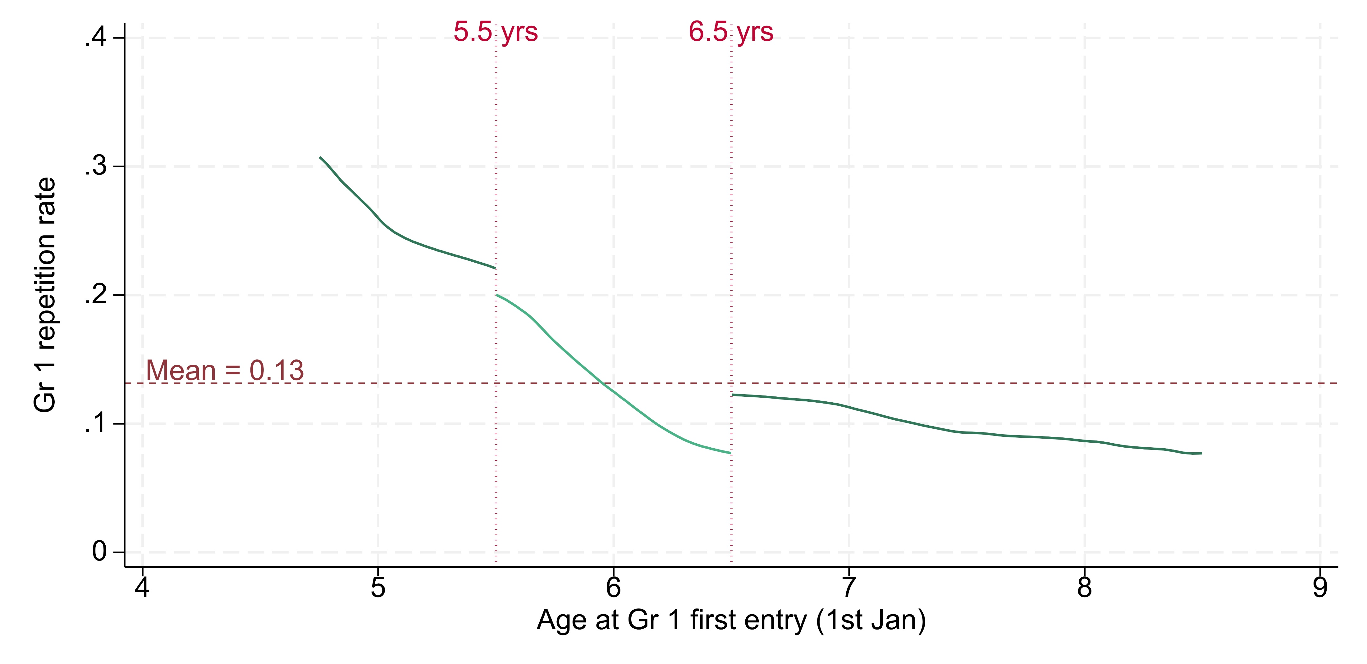
Gr 1: Entry-age is negatively related to repetition
Mid-year schools only
40%
30%
20%
13%
10%
0%
Source: The 2018 Grade 1 first-time entrants’ cohort balanced panel for Grades 1 and 4, from the DDD dataset 2017–2023 for 6 provinces: EC, GT, KZN, LP, MP and NW.

Slide 38
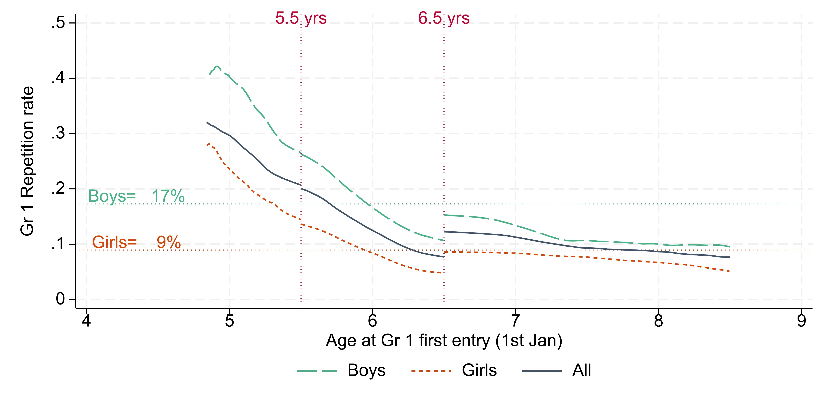
Gr 1: Boys more likely to repeat at any entry-age
Mid-year schools only
50%
40%
30%
20%
10%
0%

Slide 39
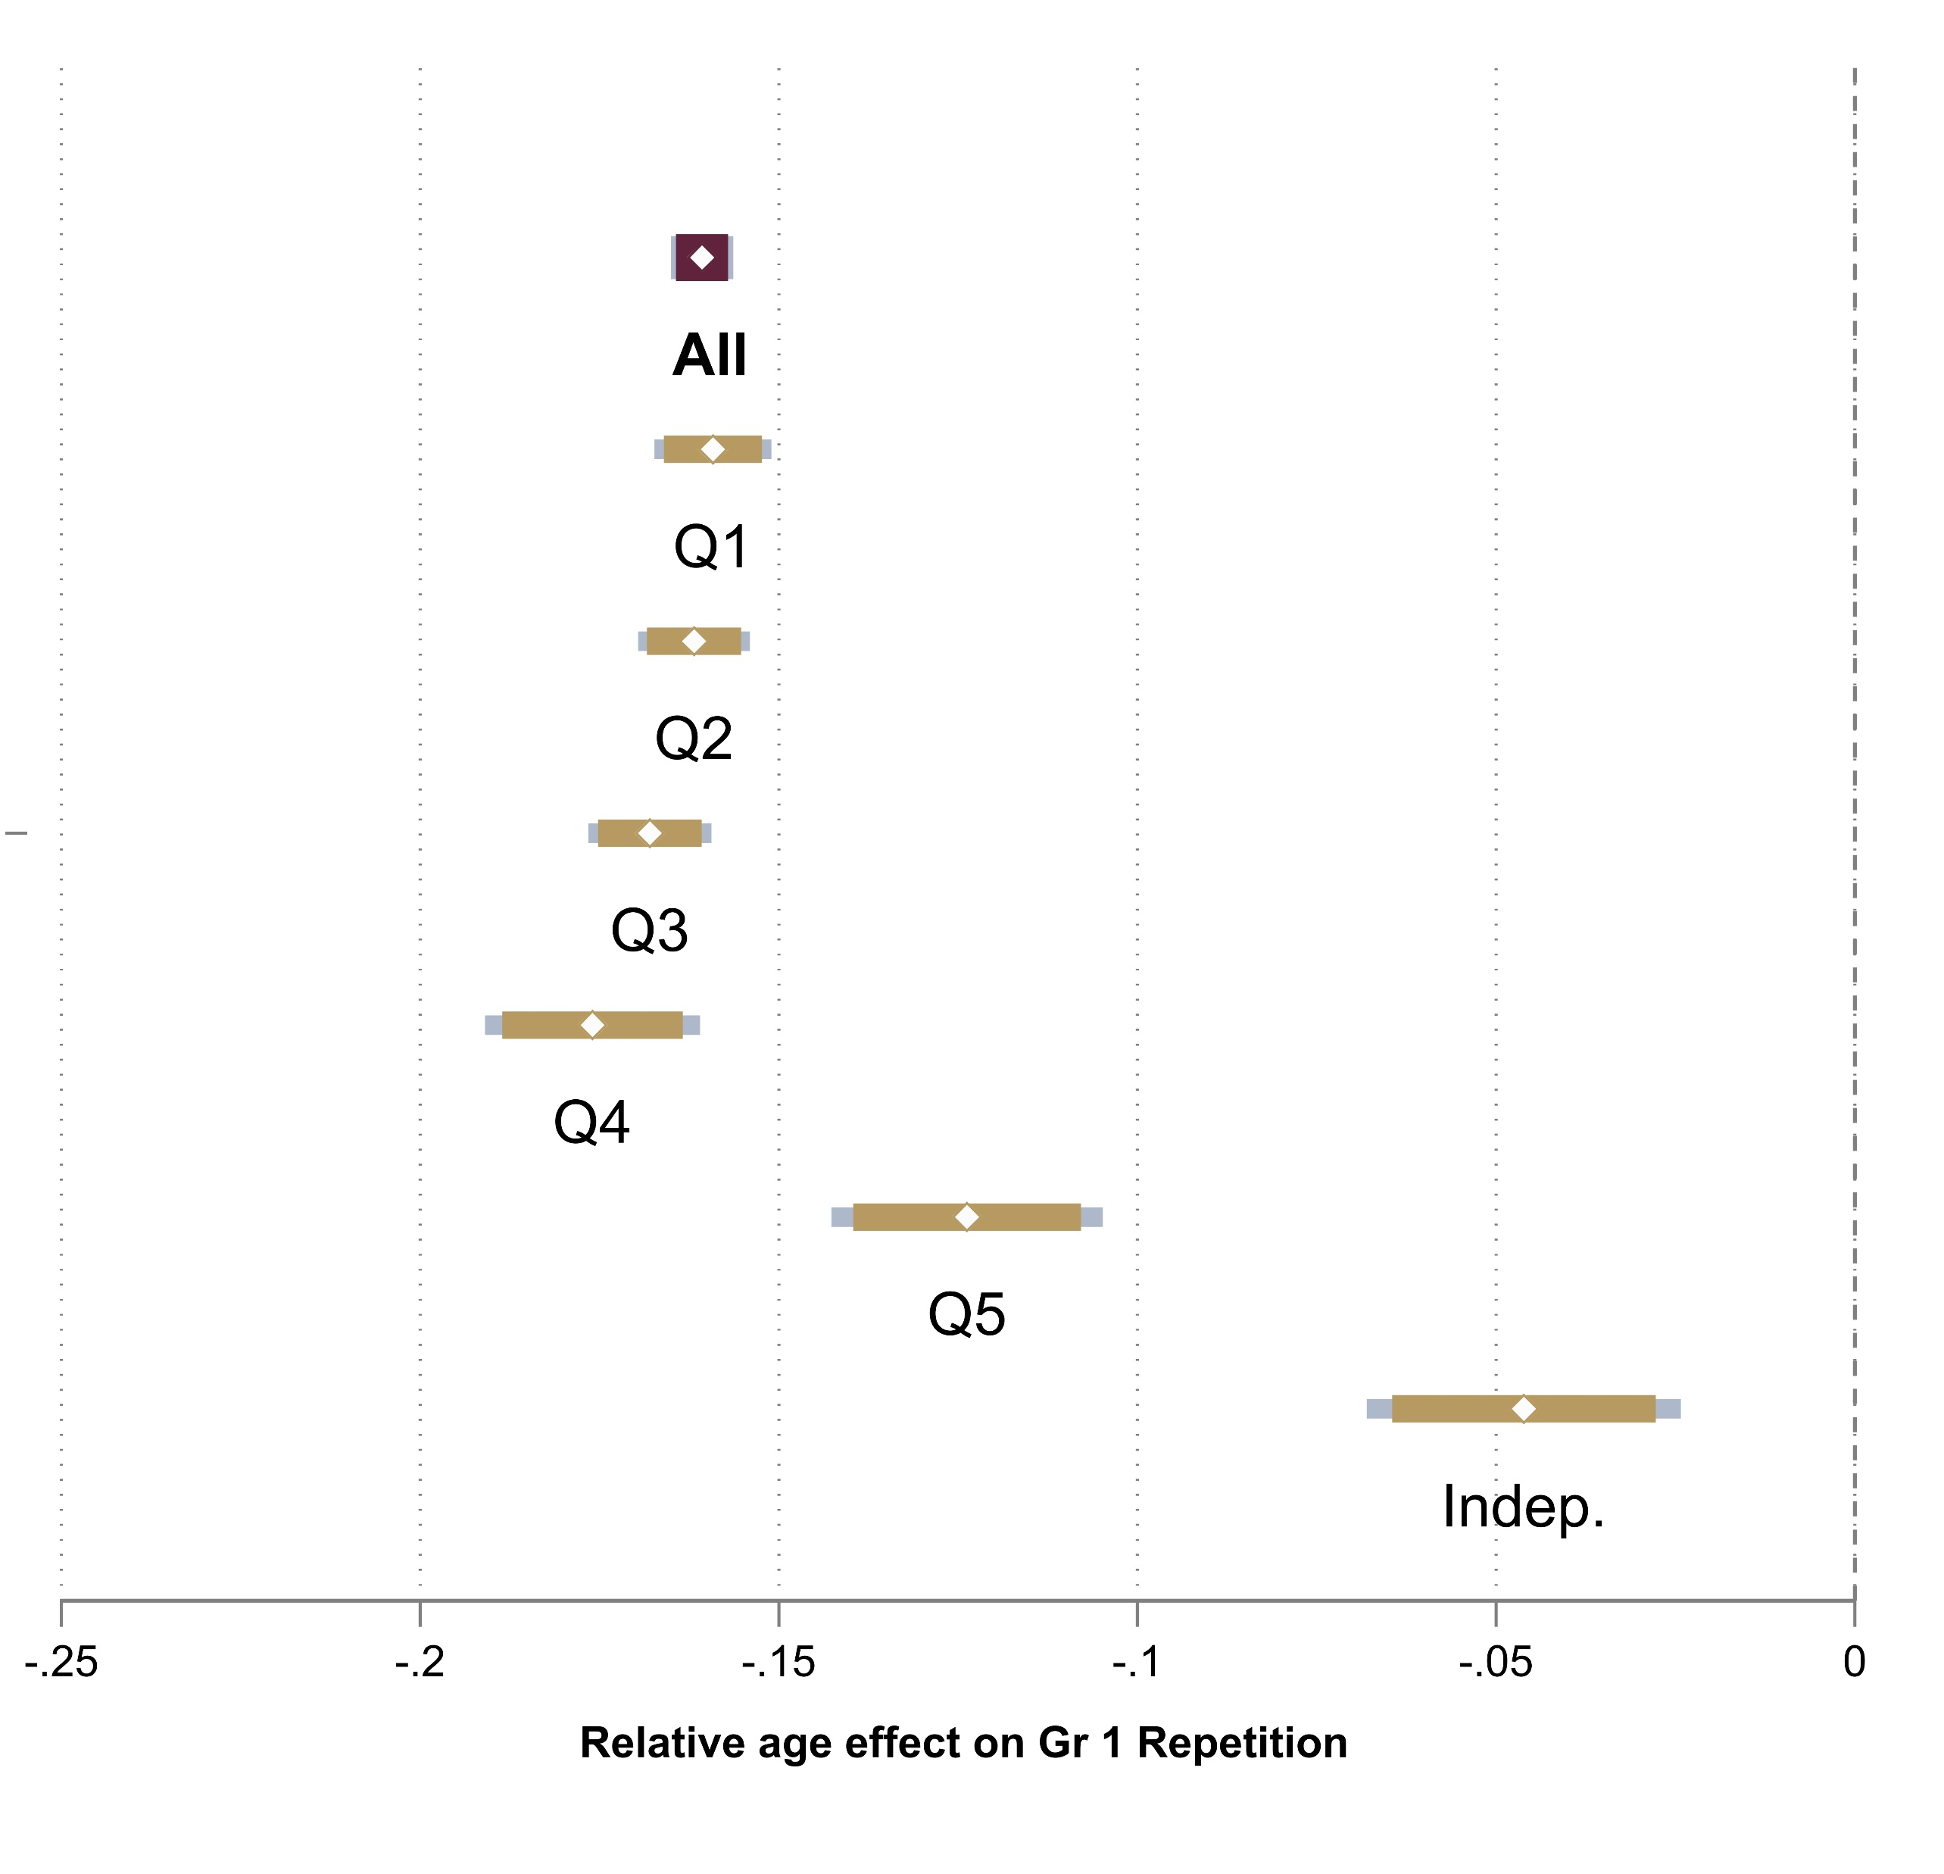
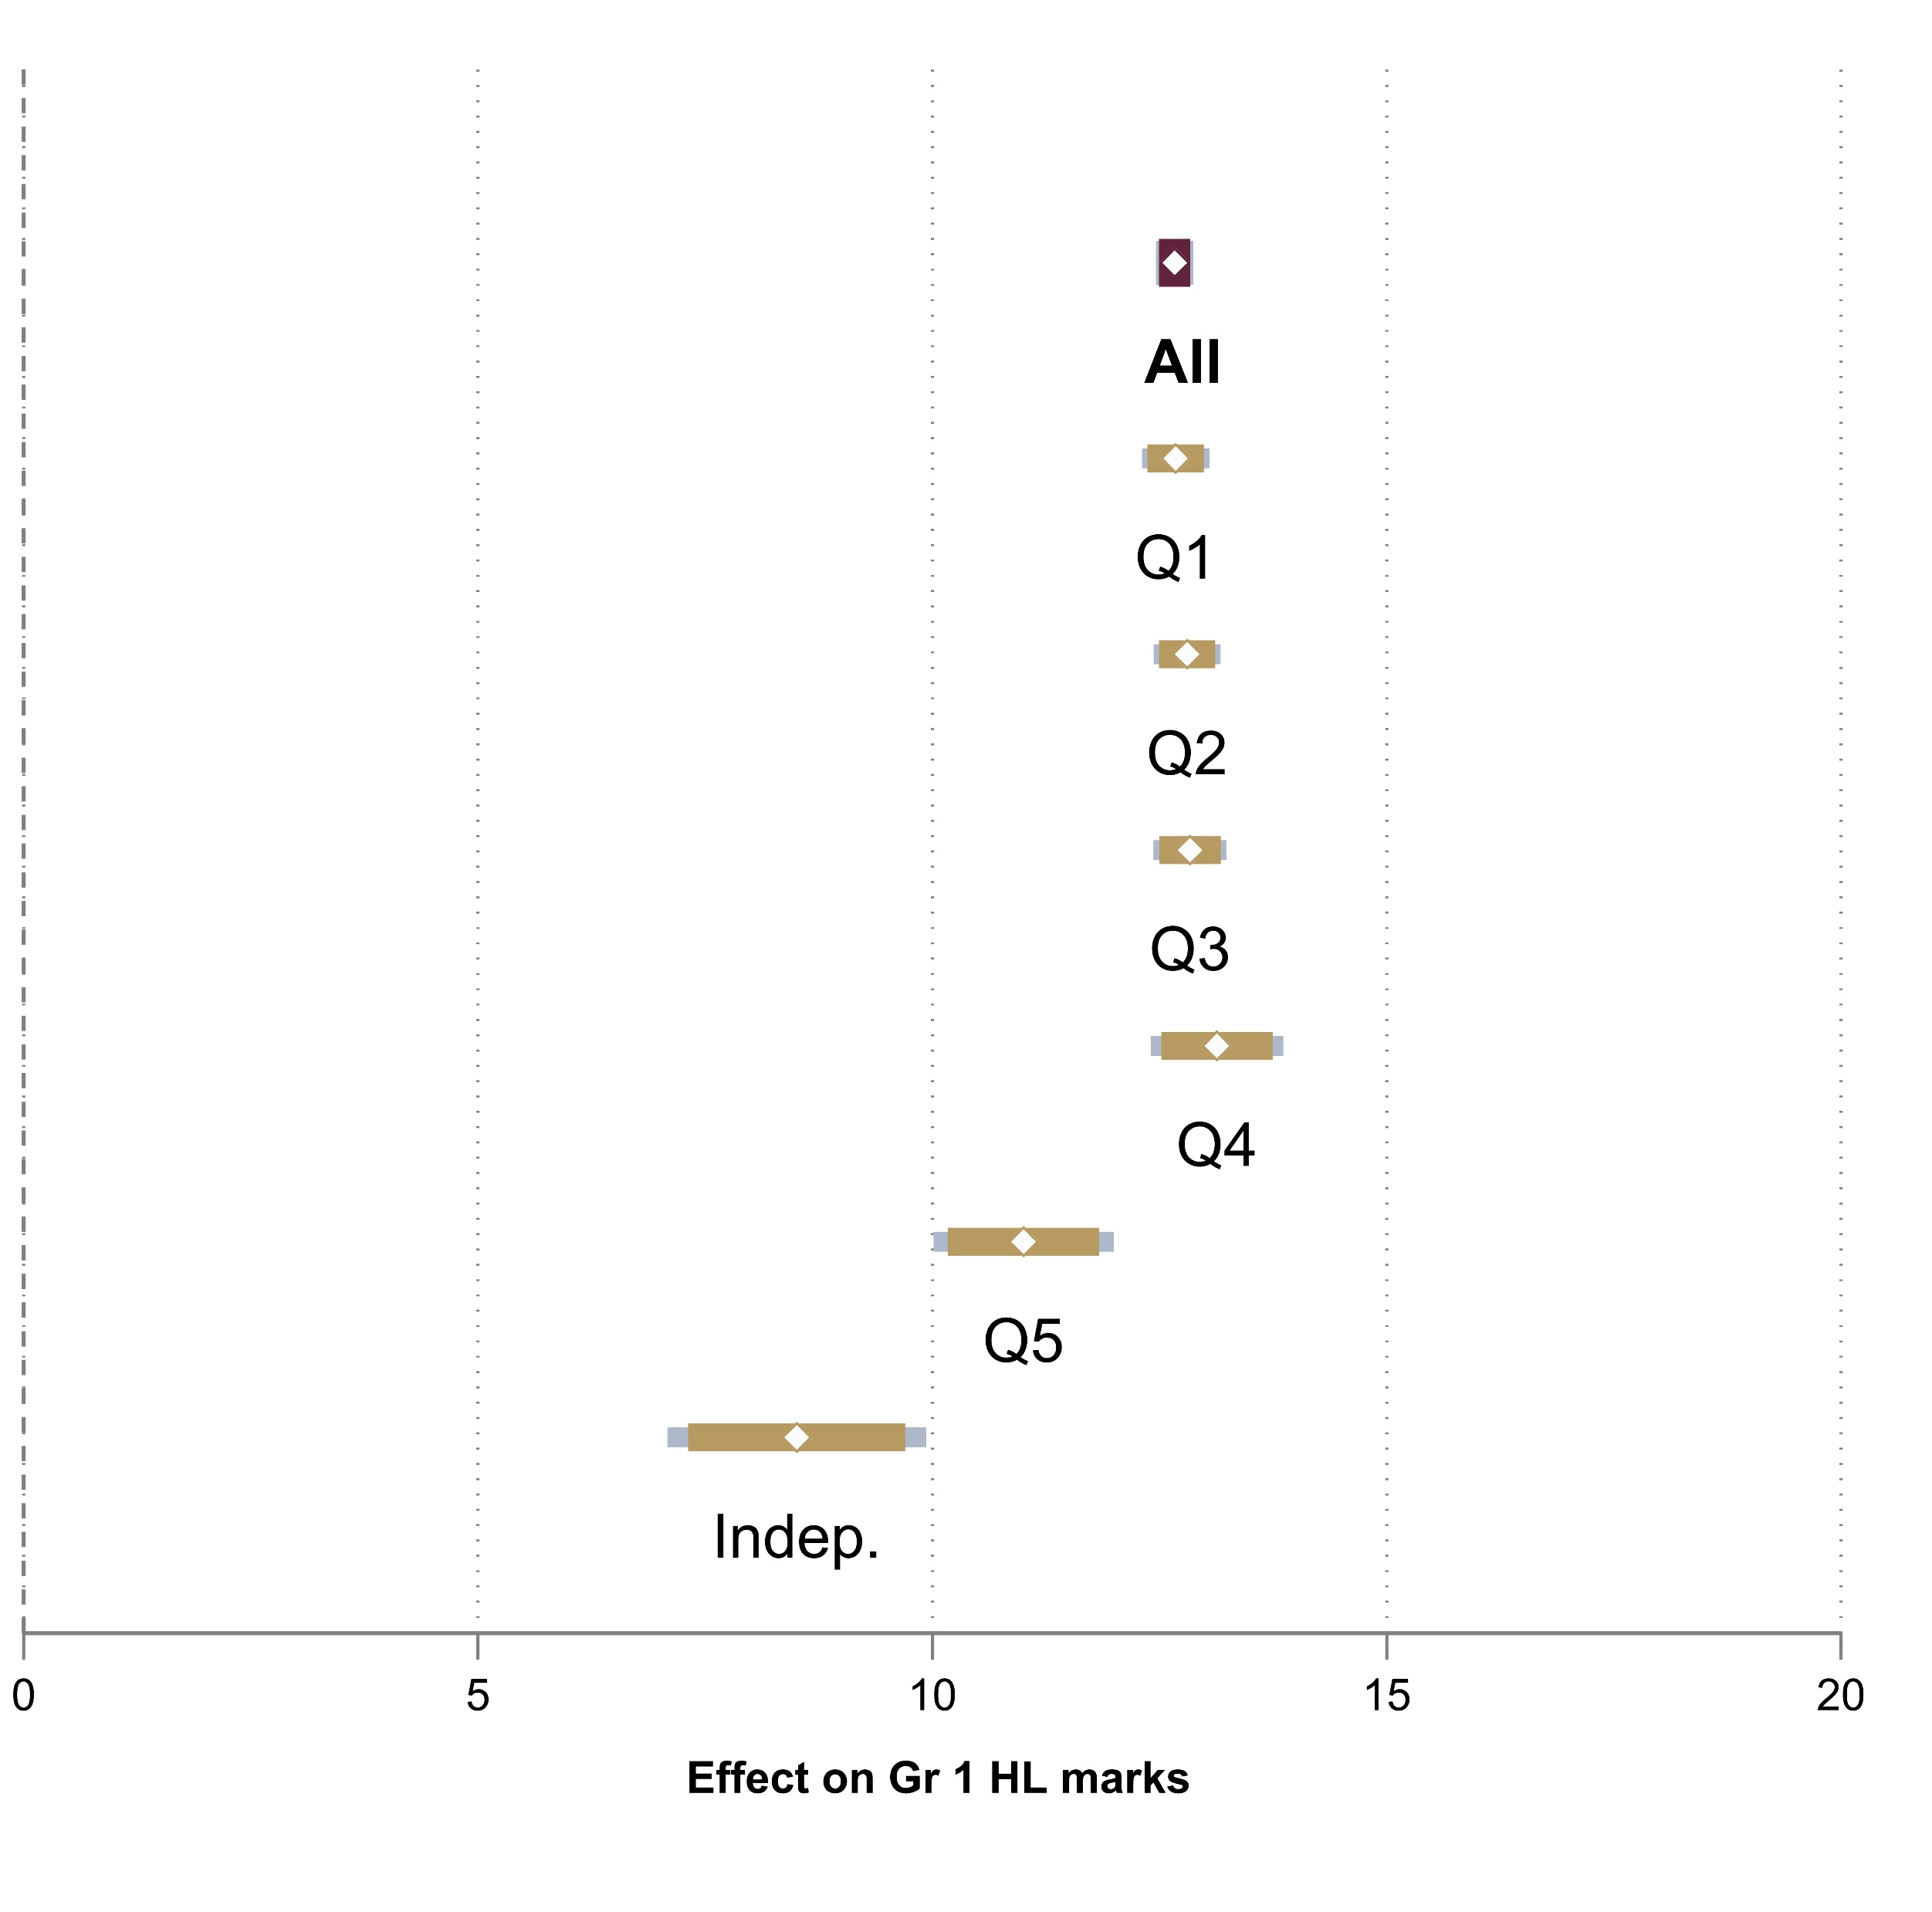


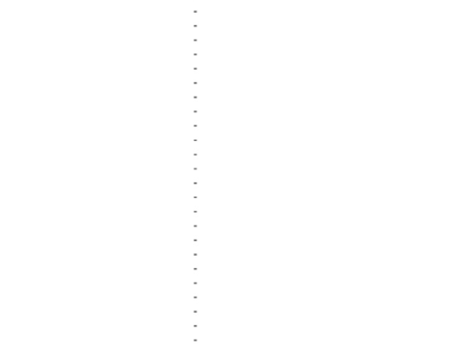

Gr 1: Bias-adjusted estimates by age of entry
Mid-year schools only
Grade 1 Repetition
Home Language Term 4 marks
16 ppt
12.7
-25
-20
-15
-10
-5
0
0
5
10
15
20
Relative age effect on Gr 1 rep. (ppts)
Relative age effect on HL marks (out of 100)
Note: 90% and 95% CIs shown

Slide 40
Gr 1: Bias-adjusted estimates by age of entry
Mid-year schools only
Grade 1 Repetition
Home Language Term 4 marks
-25
-20
-15
-10
-5
0
0
5
10
15
20
Relative age effect on Gr 1 rep. (ppts)
Relative age effect on HL marks (out of 100)
Note: 90% and 95% CIs shown

Slide 41
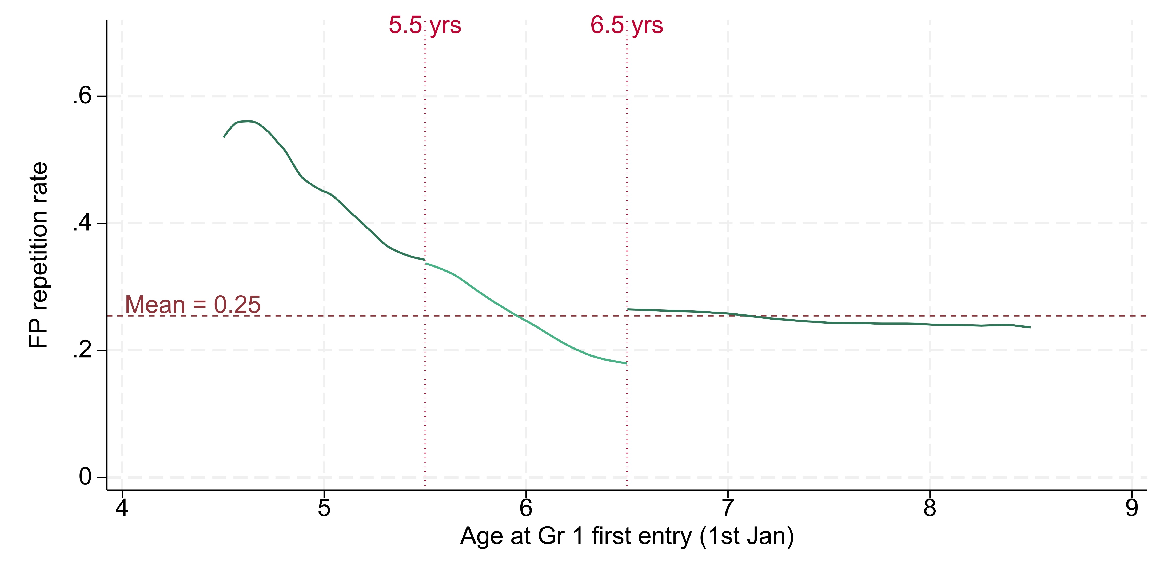
Foundation Phase: Repeating at least once
Mid-year schools only
60%
40%
25%
20%
0%
Source: The 2018 Grade 1 first-time entrants’ cohort balanced panel for Grades 1 and 4, from the DDD dataset 2017–2023 for 6 provinces: EC, GT, KZN, LP, MP and NW.

Slide 42
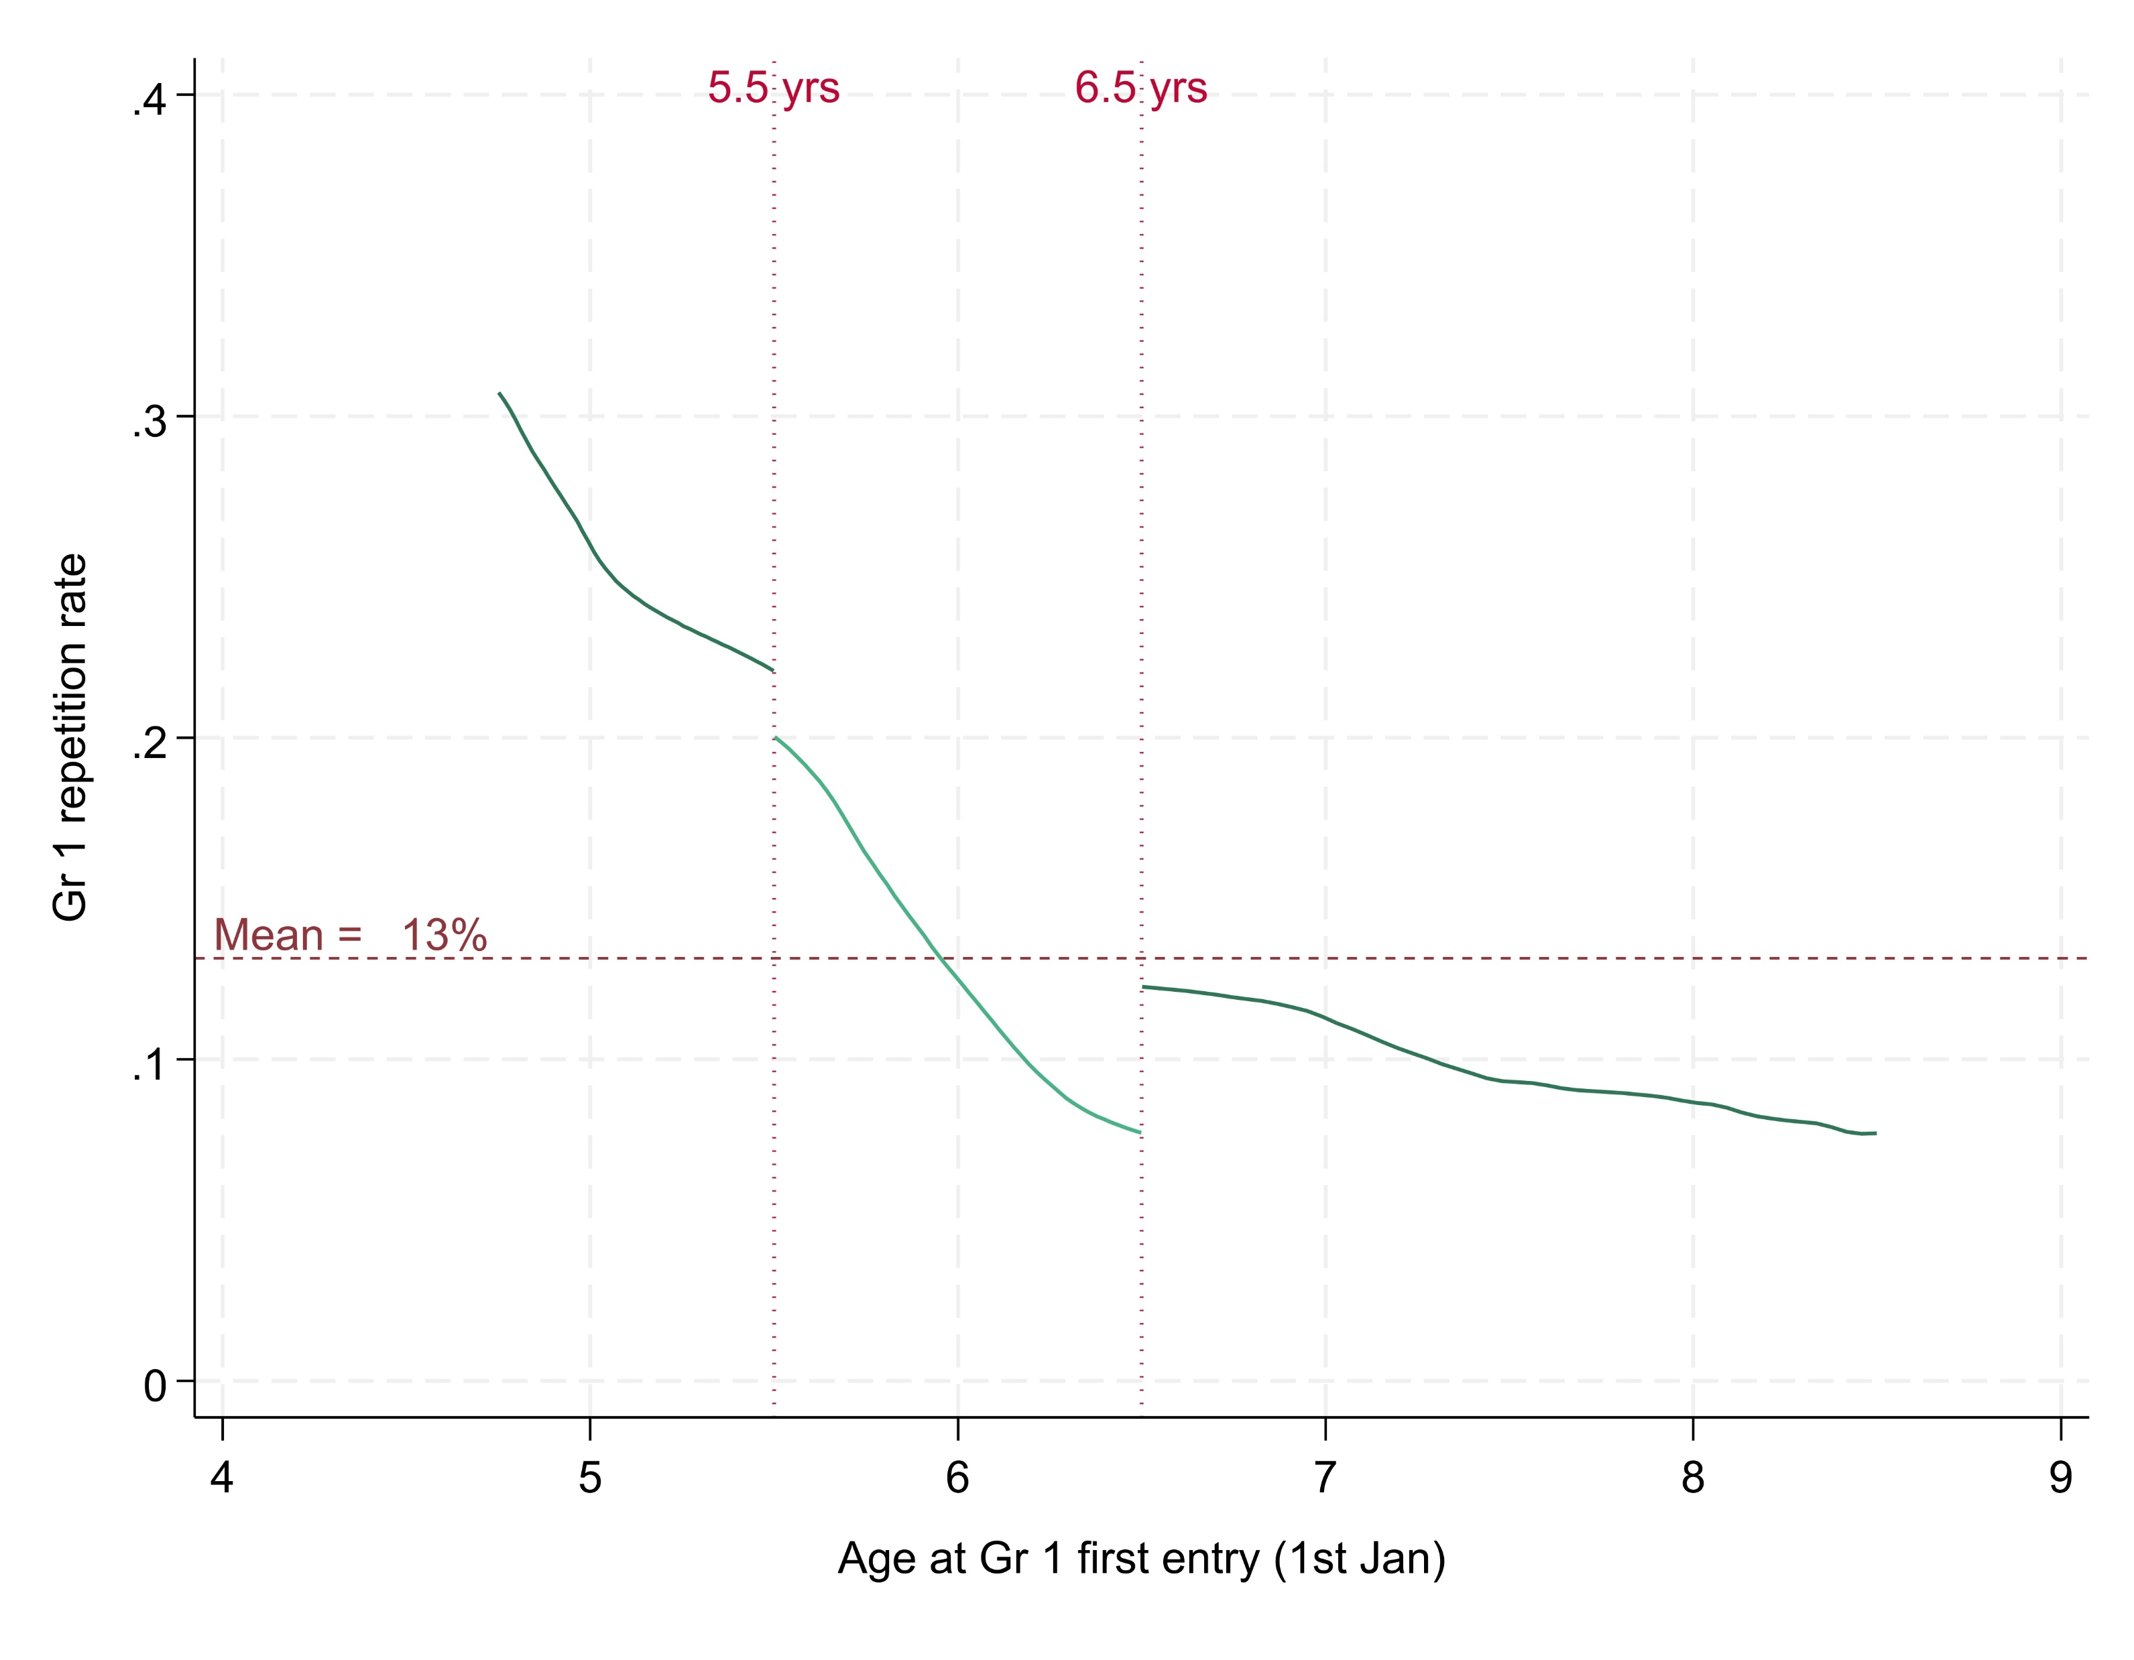
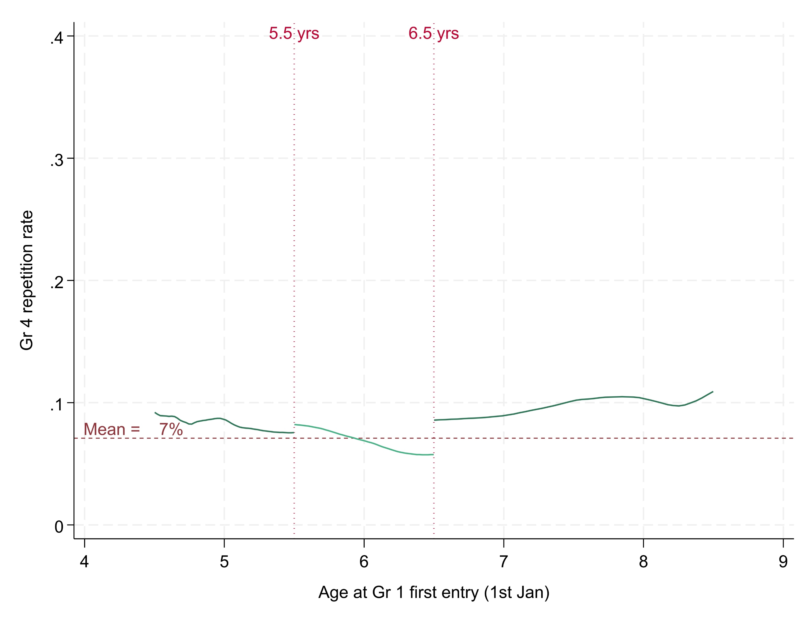
Gr 1 & 4: Age of entry and repetition in Gr4
Same grade approach
Mid-year schools only
Grade 1
Grade 4
40%
40%
30%
30%
20%
20%
Grade 1 repetition rate
Grade 4 repetition rate
10%
10%
0%
0%
Age at Gr 1 first-time entry (1st Jan)
Age at Gr 1 first-time entry (1st Jan)
Source: The 2018 Grade 1 first-time entrants’ cohort balanced panel for Grades 1 and 4, from the DDD dataset 2017–2023 for 6 provinces: EC, GT, KZN, LP, MP and NW.

Slide 43
Gr 1 → Gr 4: Academic rank improvements
Same grade approach
Mid-year schools only
Probability of moving up 2 percentiles in the school ranking from Gr 1 to Gr 4
Gr 1 Home lang. Quartile | Birth Quartile
 | 1 (Oldest) | 2 | 3 | 4 (Youngest)
1 (Lowest marks) | 64% | 66% | 67% | 69%
2 | 47% | 49% | 51% | 52%
3 | 37% | 39% | 40% | 40%
4 (Highest marks) | 25% | 25% | 26% | 26%
Source: The 2018 Grade 1 first-time entrants’ cohort balanced panel for Grades 1 and 4, from the DDD dataset 2017–2023 for 6 provinces: EC, GT, KZN, LP, MP and NW.
Notes:
Say that this looks from Grade 1 to Grade 4 Make discussion of table quicker.

Slide 44
Gr 1 → Gr 4: Academic rank improvements
Same grade approach
Mid-year schools only
Probability of moving up 2 percentiles in the school ranking from Gr 1 to Gr 4
Gr 1 Home lang. Quartile | Birth Quartile
 | 1 (Oldest) | 2 | 3 | 4 (Youngest)
1 (Lowest marks) | 64% | 66% | 67% | 69%
2 | 47% | 49% | 51% | 52%
3 | 37% | 39% | 40% | 40%
4 (Highest marks) | 25% | 25% | 26% | 26%
Source: The 2018 Grade 1 first-time entrants’ cohort balanced panel for Grades 1 and 4, from the DDD dataset 2017–2023 for 6 provinces: EC, GT, KZN, LP, MP and NW.
Notes:
Say that this looks from Grade 1 to Grade 4 Make discussion of table quicker.

Slide 45
Gr 1 → Gr 4: Academic rank improvements
Same grade approach
Mid-year schools only
Probability of moving up 2 percentiles in the school ranking from Gr 1 to Gr 4
Gr 1 Home lang. Quartile | Birth Quartile
 | 1 (Oldest) | 2 | 3 | 4 (Youngest)
1 (Lowest marks) | 64% | 66% | 67% | 69%
2 | 47% | 49% | 51% | 52%
3 | 37% | 39% | 40% | 40%
4 (Highest marks) | 25% | 25% | 26% | 26%
Source: The 2018 Grade 1 first-time entrants’ cohort balanced panel for Grades 1 and 4, from the DDD dataset 2017–2023 for 6 provinces: EC, GT, KZN, LP, MP and NW.
Notes:
Say that this looks from Grade 1 to Grade 4 Make discussion of table quicker.

Slide 46
Gr 1 → Gr 4: Academic rank improvements
Same grade approach
Mid-year schools only
Probability of moving up 2 percentiles in the school ranking from Gr 1 to Gr 4
Gr 1 Home lang. Quartile | Birth Quartile
 | 1 (Oldest) | 2 | 3 | 4 (Youngest)
1 (Lowest marks) | 64% | 66% | 67% | 69%
2 | 47% | 49% | 51% | 52%
3 | 37% | 39% | 40% | 40%
4 (Highest marks) | 25% | 25% | 26% | 26%
Source: The 2018 Grade 1 first-time entrants’ cohort balanced panel for Grades 1 and 4, from the DDD dataset 2017–2023 for 6 provinces: EC, GT, KZN, LP, MP and NW.
Notes:
Say that this looks from Grade 1 to Grade 4 Make discussion of table quicker.

Slide 47
Fade-out of relative-age effect is larger for learners in the bottom half of the Gr1 performance distribution
Partially achieved through repetition

Slide 48



Younger learners are the most likely to repeat in the FP
Learners who repeat…
Receive one additional year of schooling
Become one year
older
Are assessed in a different year (later cohort)

Slide 49
Discussion: School-readiness conundrum
Poorest
Richest
Source: Thrive-by-Five Index Report, Giese et. al (2022), Tracking national sample of learners at early learning programmes, aged 50 – 59 months (between 4 and 5 years)

Slide 50
Discussion: School-readiness conundrum
Least school-ready children, attend schools where earlier entry (5 ½ - 6 ½ yrs) is the norm, with higher repetition
Need to consider alternatives available (ELPs and Gr R) when thinking about changing entry-age
Increase awareness and information available to parents. ELP involvement in school readiness discussion
Poorest
Richest
Source: Thrive-by-Five Index Report, Giese et. al (2022), Tracking national sample of learners at early learning programmes, aged 50 – 59 months (between 4 and 5 years)

Slide 51
Discussion: Summary
Admissions legislations makes provision for an 18-month period to enter Grade 1¹
But schools tend to implement one of two de-facto school-entry-age policies: Mid-year or Calendar Year
High levels of compliance with school-entry-age policy
Some improvements over time. Early entry for Gr R and Gr 1 could be reduced even further
Gr 1 (and FP) repetition and academic performance are strongly related to school-entry-age
Some fade-out of the relative age effect observed by Gr 4
¹ This has now been changed in the BELA Bill (2024) to include Grade R, so the starting age has shifted to the year in which a child turns six (6)

Slide 52
Conclusion
Current legislation has built-in flexibility and high levels of compliance
It is working as intended
Considering school-entry age options is relevant to optimisation and cost efficiency discussions due to repetition, but changes require quality pre-school alternatives
Adjusting the age of entry does not change instructional practice
Likely not a key lever to improve system-level learning outcomes

Slide 53
Thank you!

Slide 55
Implementation of applied school-entry-age policy
Home Language
Race
% of Learners
Source: The 2018 Grade 1 first-time entrants’ cohort balanced panel for Grades 1 and 4, from the DDD dataset 2017–2023 for 6 provinces: EC, GT, KZN, LP, MP and NW.

